Slide 1
CSE 3100: Systems Programming
Lecture 7 : More on Memory, Pointers and Structures
Department of Computer Science and Engineering
University of Connecticut

Slide 2
1. Array Memory
More on Memory Lecture Topics
2. Pointer Arithmetic
3. Structures

Slide 3
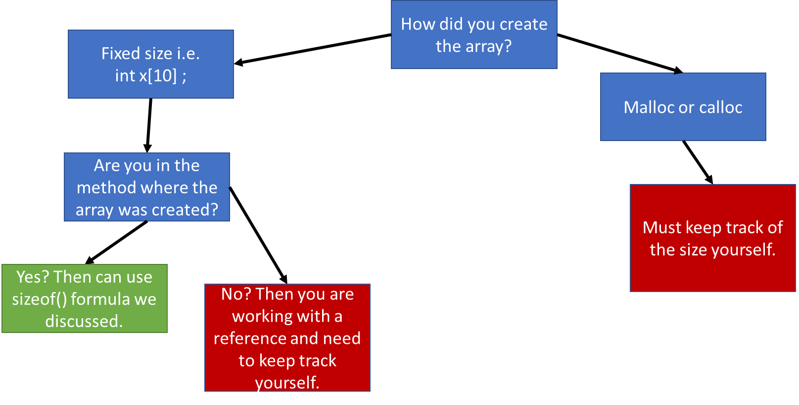
Review from last lecture: Memory Allocation

Slide 4
Review from last lecture: Memory Allocation
Two ways to create arrays:
int x[3];
int *x = malloc(sizeof(int) * 3)
In functions why would we want to use malloc over the “[]” approach?

Slide 5

In functions why would we want to use malloc over the “[]” approach?
When we declare arrays in functions with the “[]” approach that memory is allocated from the stack.
The stack is a FIXED size, so we could actually run out of memory in a function call if we use an especially large “[]” array.
The heap is not a fixed size and in general larger.
Also extremely important: we cannot take non-static stack variables outside of the function call, like we can with malloc…
Car Salesman: *slaps roof of heap*
“This bad boy can hold so many arrays in it”
Heap

Slide 6
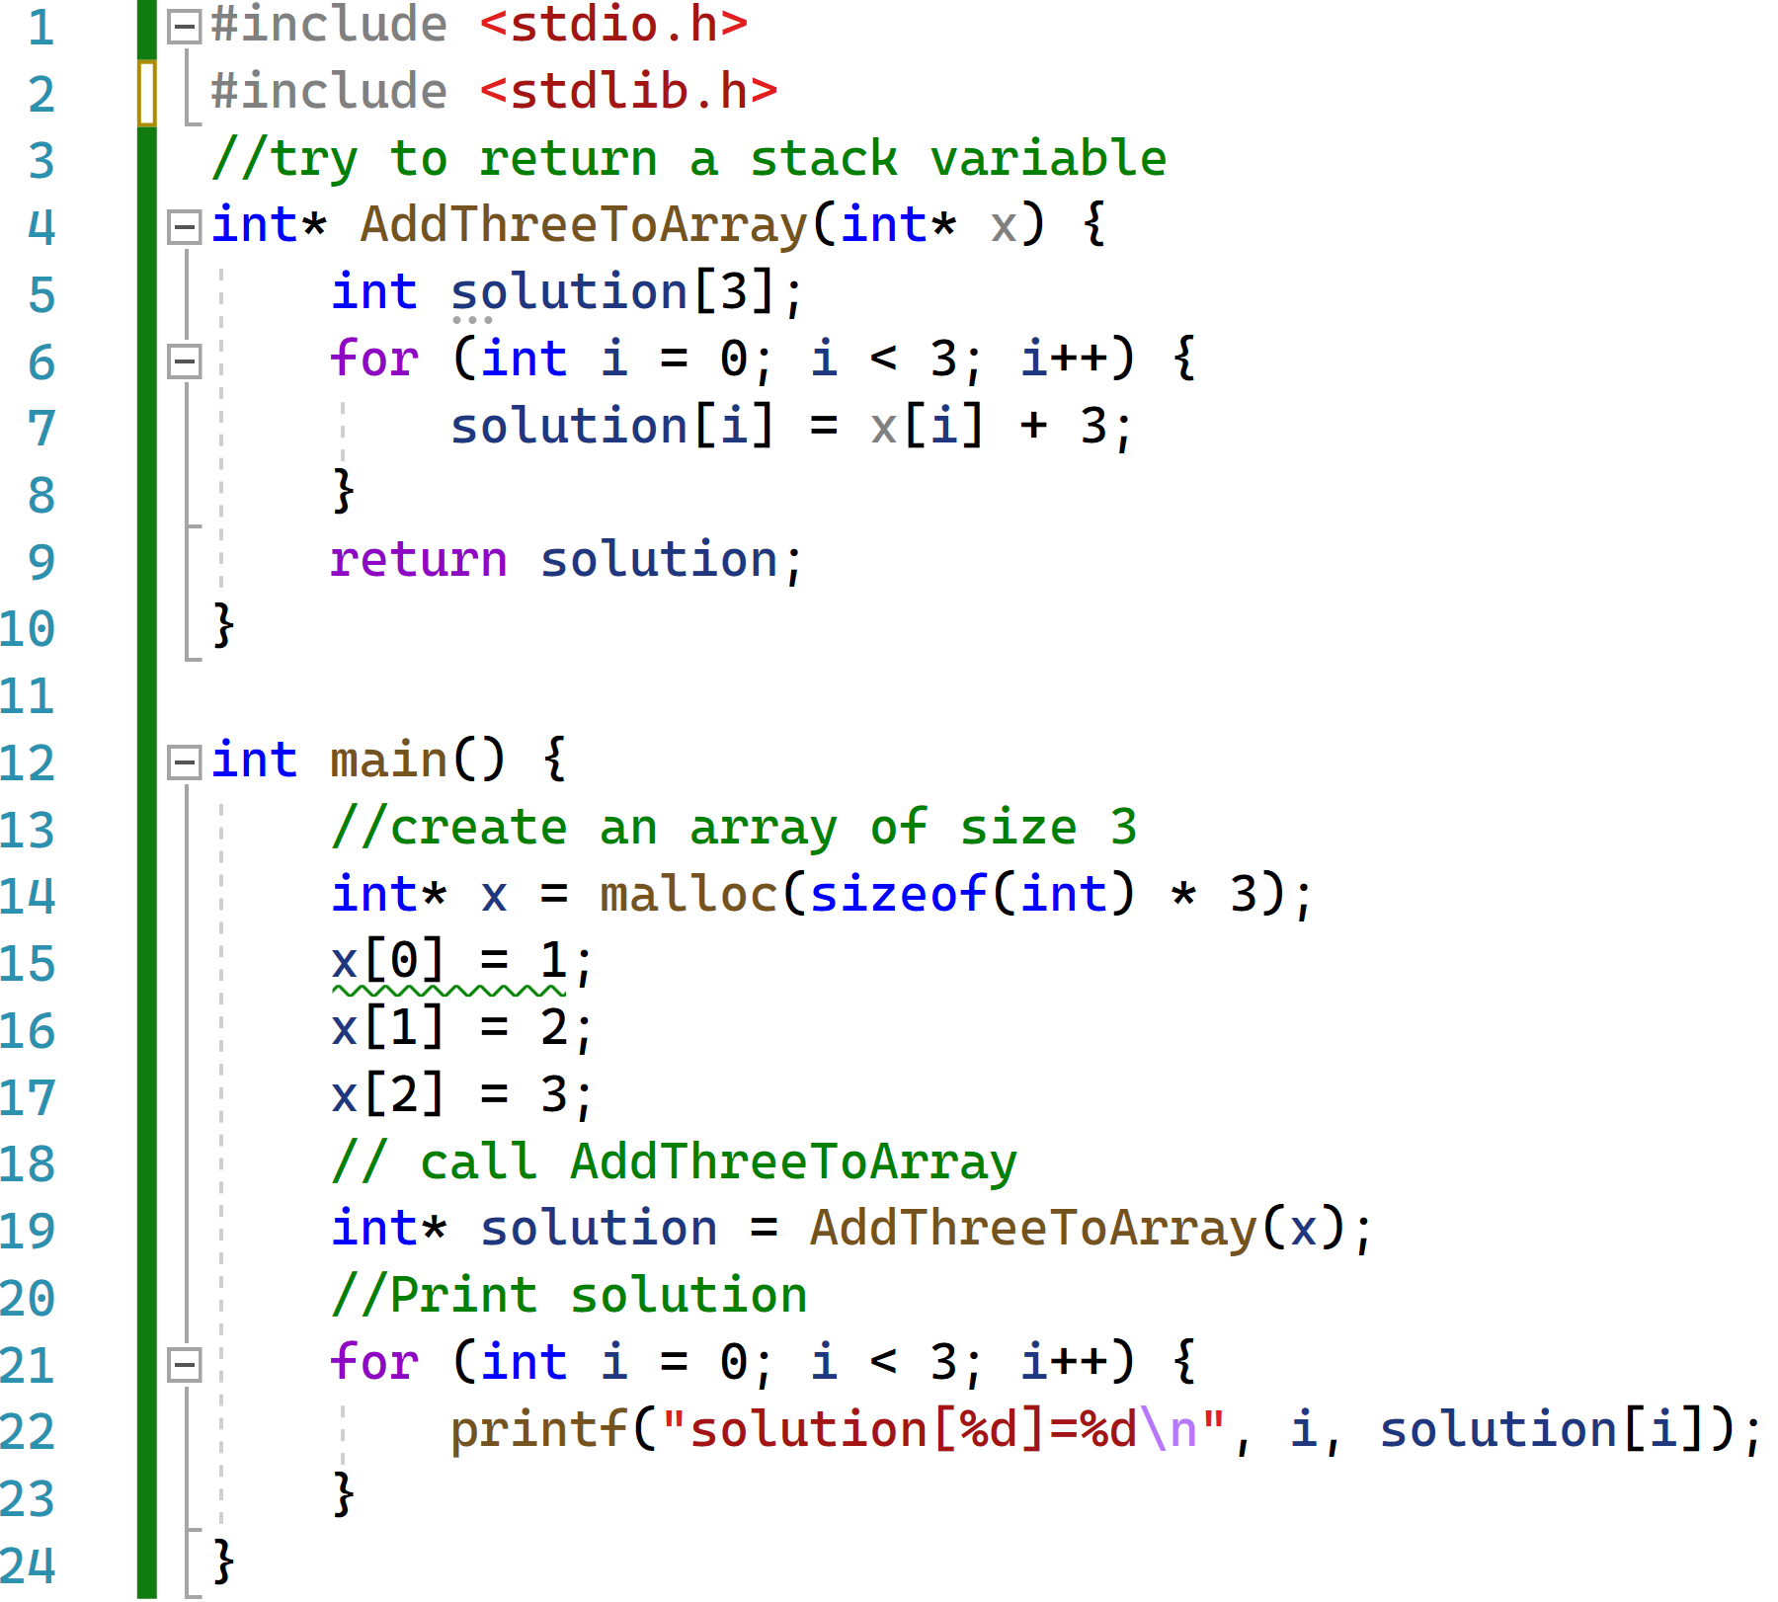
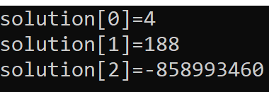

Question: What will this code print out
Ideally we want: the solution to be {4,5,6} right?
When you try to return stack variables from functions:
Stack Variable

Slide 7
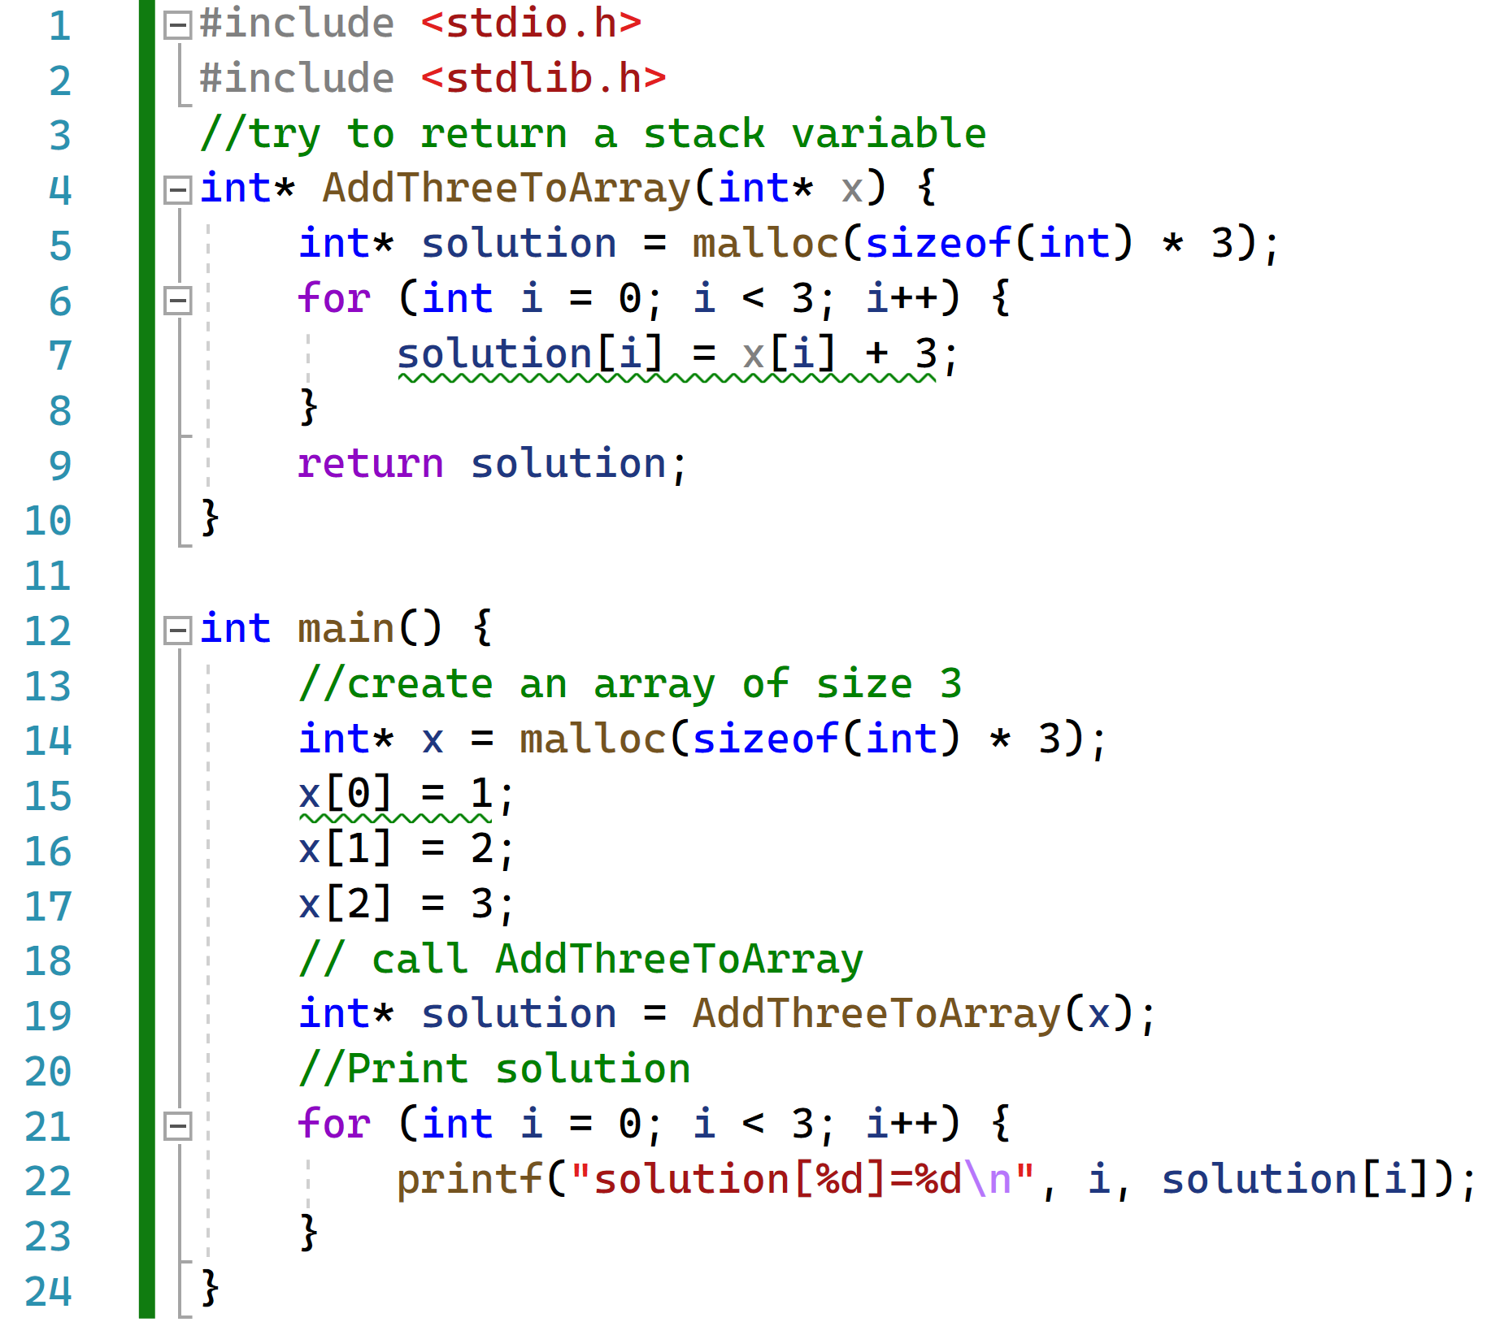
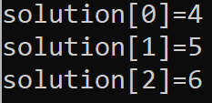
Will this code work? If so why?
Answer: Yes because malloc takes memory from the heap NOT the stack. Once allocated by us, the heap memory is only freed by us.

Slide 8
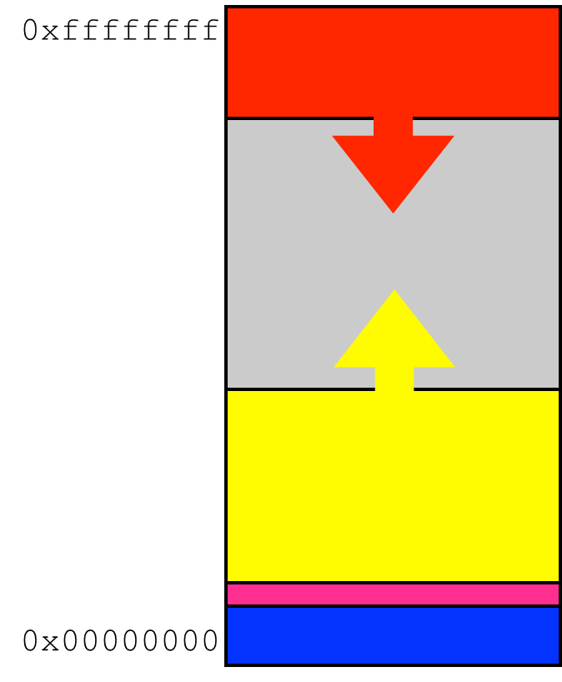
So should we just never use “[]” arrays that come from the stack?
The answer is not that simple.
In this class we treat memory as one big block (with three different sections).
So it seems like it doesn’t matter if we are taking memory from the heap or the stack as both are just pieces from the same block.
In reality, stack memory can be accessed faster than the heap. You’ll learn about this more in an operating system class probably.

Slide 9
1. Array Memory
2. Pointer Arithmetic
3. Structures

Slide 10
Pointers are addresses
The value of a pointer is a byte address
  Unsigned integer used to number bytes in memory
  Range is between
    0x00000000 and 0xFFFFFFFF [32-bit]
    0x0000000000000000 and 0xFFFFFFFFFFFFFFFF [64-bit]
If a pointer is an integer, you can do arithmetic…
To compute other addresses

Slide 11
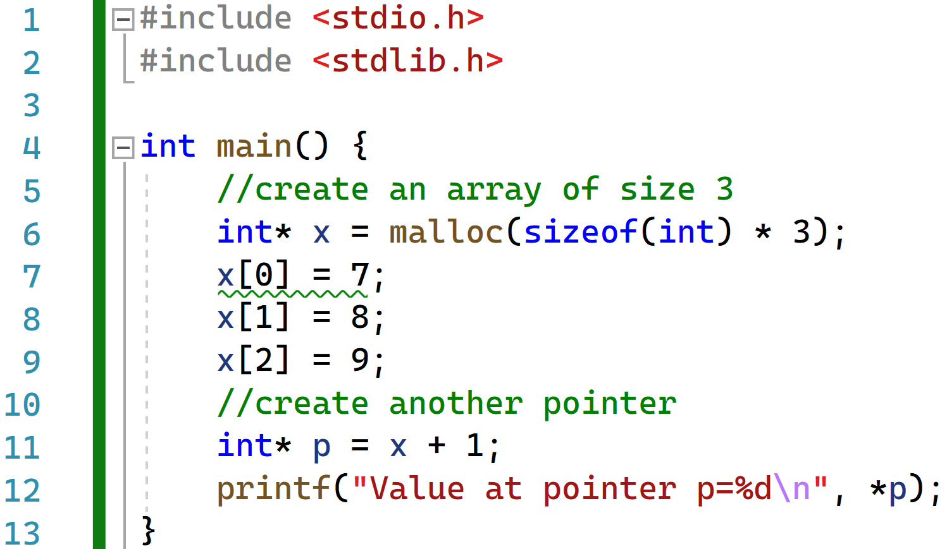

Simple Pointer Example: What value is p pointing to?

Slide 12

There may be some confusion…
Recall x is an integer pointer to an address in memory.
p = x + 1
It seems if we add 1 to it we should get 993.
But actually p is pointing to 996.
Address | Value
1020
1016
1012
1008
1004
1000 | 9
996 | 8
992 | 7
p
x

Slide 13
Adding a pointer and an integer
Add an integer to a pointer, the result is a pointer of the same type
  It is different from regular integer addition
  The integer is automatically scaled by the size of the type pointed to
Suppose p is a pointer to type T, and k is an integer
Then both p + k and k + p
    Are valid expressions that evaluate to a pointer to type T
    Have a byte address equal to
(unsigned long)(address stored in p) + k * sizeof(T)

Slide 14
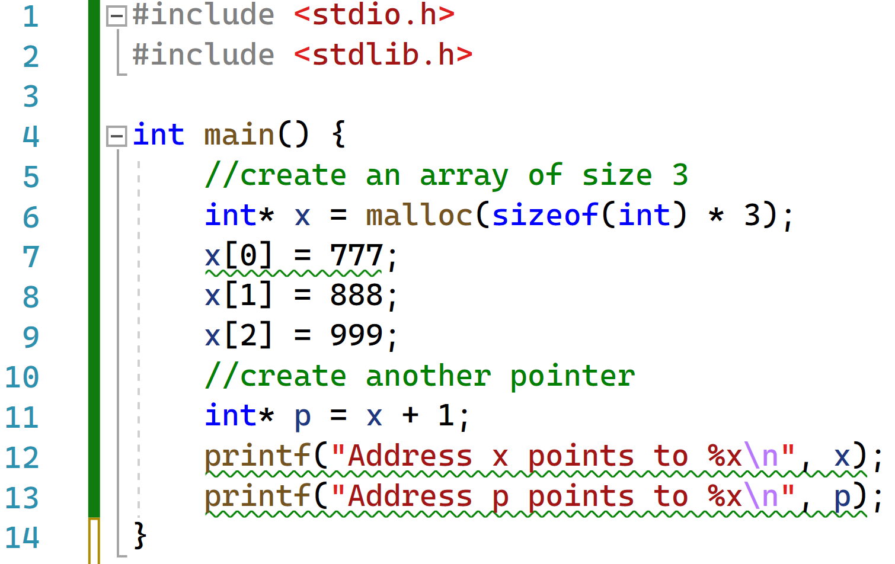

Can we actually see the addresses?

Slide 15
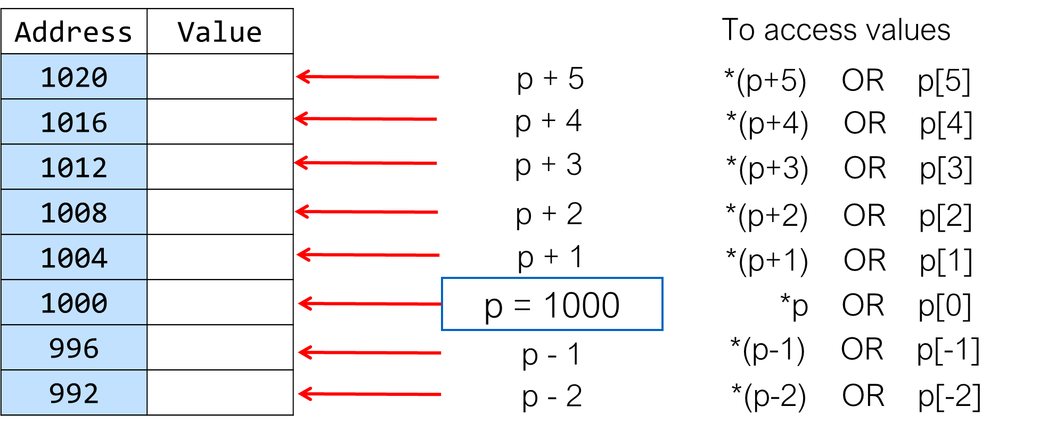
Pointer Addition
Suppose p is a pointer to an int, and its value is 1000
p + 1 is not the next byte address.
It is the address of next item (of type int)

Slide 16
Pointers Subtraction
Subtract one pointer from another: both must have the same type
The result is the number of data items between the two pointers!
    Not the number of bytes
#include <stdio.h>
#include <stdlib.h>
int main() {
int *p = malloc(sizeof(int)*10);
int *last = p + 9;
int dist = last - p; // both are int *
printf("Distance is %d\n",dist);
free(p);
return 0;
}
Output
$ gcc ptrsub.c
$ ./a.out
Distance is 9
$

Slide 17
Pointer comparisons
You can also compare two pointers
  < > <= >= != ==
Purpose
  Check boundary conditions in arrays
  Manually manage memory blocks
Semantics
  Simply based on memory layout
  Compare bits in pointers as unsigned integers

Slide 18
Effect of casting types
If you cast a pointer type…
  Any subsequent pointer arithmetic will use the type you chose
Do not want scaling? Casting a pointer to (char *)
  Because sizeof(char) is 1
int * t;
char * p = (char *) t + 8; // 8 is not scaled
char * q = (char *) (t + 8); // 8 is scaled

Slide 19
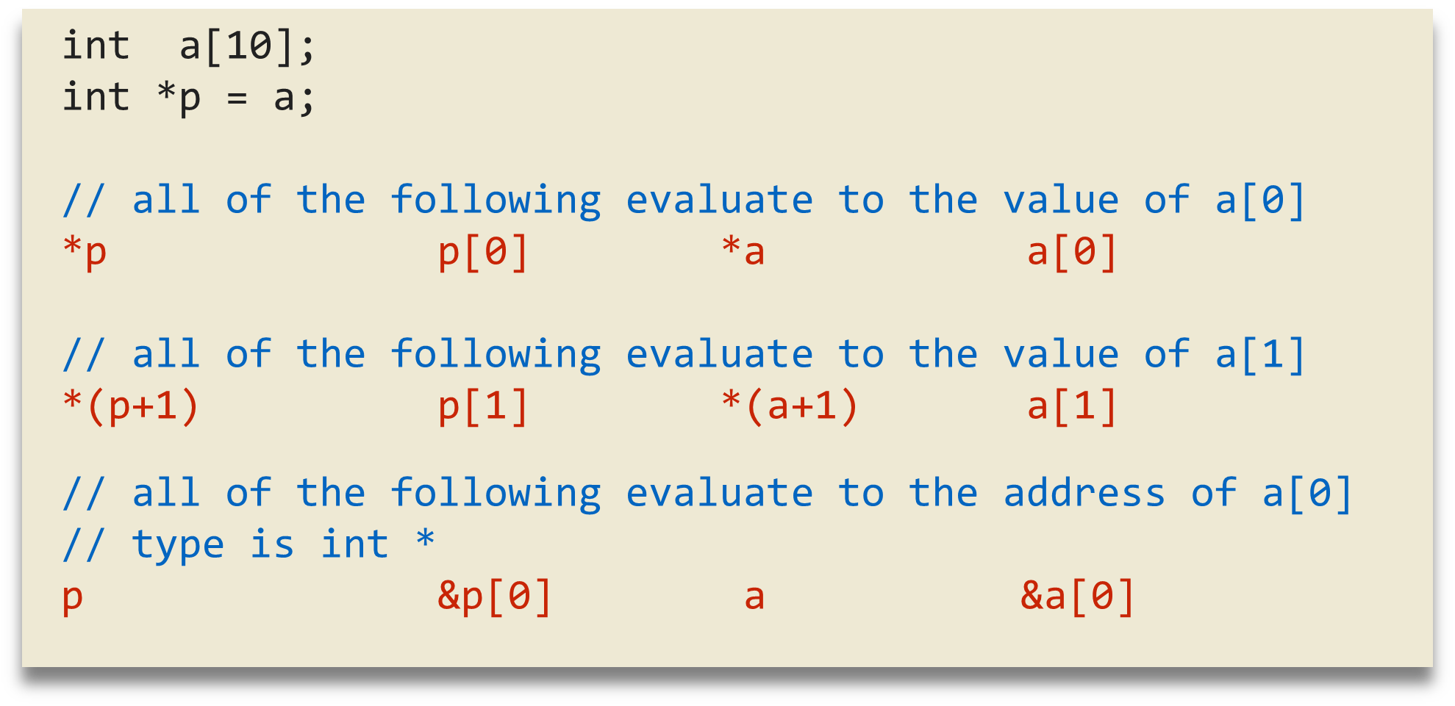
Arrays and Pointers 1
Arrays and pointers can often be used interchangeably
"array of int" becomes "pointer to int" (array decay)

Slide 20
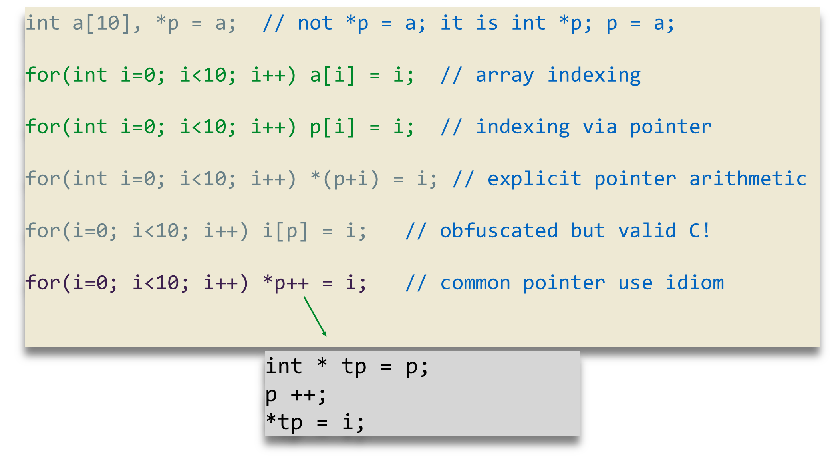
Arrays and Pointers 2
Equivalent ways of initializing an array

Slide 21

Are arrays and pointers the same?

Slide 22
Visualization of Pointer vs Array
In this visualization x in an array and p is a pointer.
Address | Value
1020
1016
1012 | 992
1008
1004
1000 | 9
996 | 8
992 | 7
p
x

Slide 23
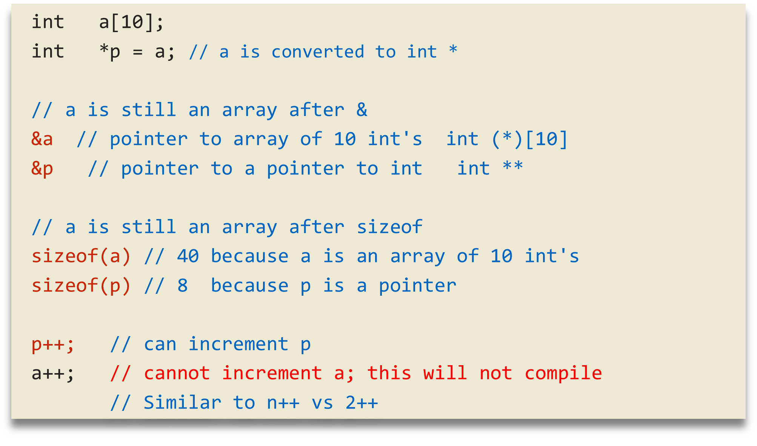
Arrays and pointers are NOT the same

Slide 24
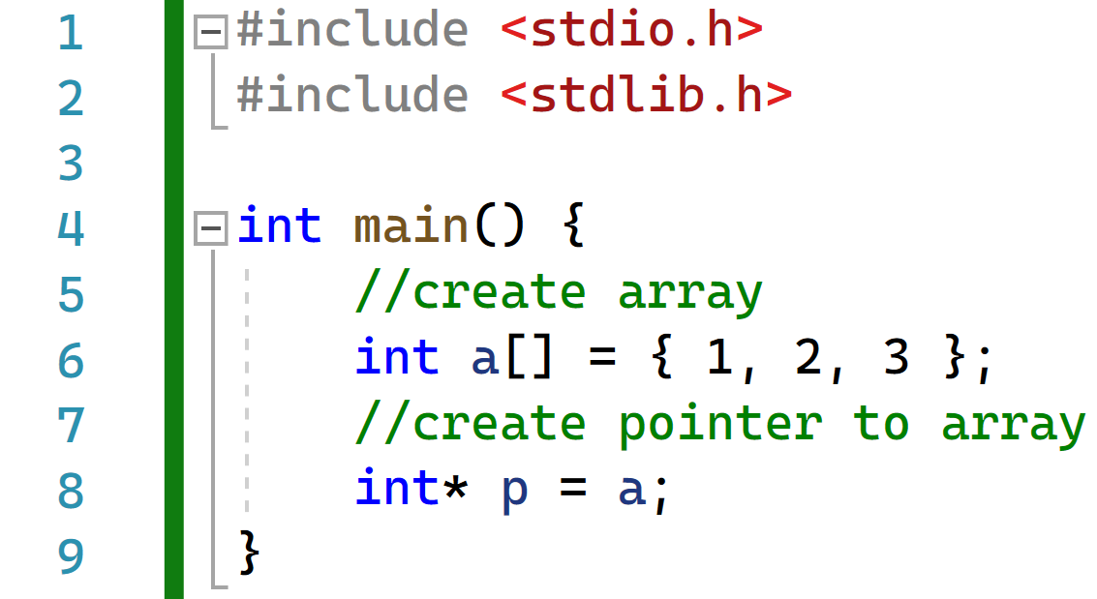
Code example to further illustrate the point…
Address | Value
1020
1016
1012
1008
1004
1000
996
992

Slide 25
Code example to further illustrate the point…
Address | Value
1020
1016
1012
1008
1004
1000 | 3
996 | 2
992 | 1
p
x

Slide 26
Code example to further illustrate the point…
Address | Value
1020
1016
1012 | 992
1008
1004
1000 | 3
996 | 2
992 | 1
p
x

Slide 27
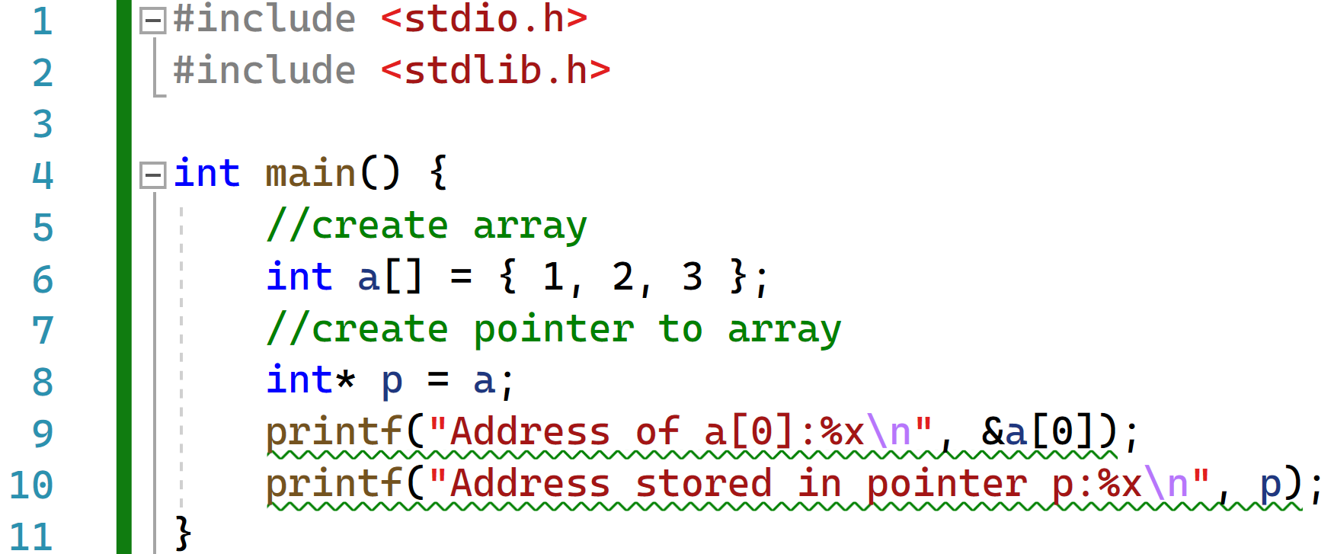

Showing the Address for Further Proof
We can actually print out the address to see that the pointer is point to the address AND the array value is stored at that address:

Slide 28
1. Array Memory
2. Pointer Arithmetic
3. Structures

Slide 29

Structures

Slide 30
Structures
Mechanism to define new types
  Also known as “compound types”
  Used to aggregate related variables of different types
Structures type declaration
  Structures can have a type name
  Can have “members” of any type
    Basic types
    Pointers
    Arrays
    Other structures
Structure variable definition
  Specifies variable name
struct student_grade {
  char *name;
  int id;
  char grade[3];
};
…
struct student_grade student1;
struct student_grade student2, student3;
struct student_grade all[200];

Slide 31
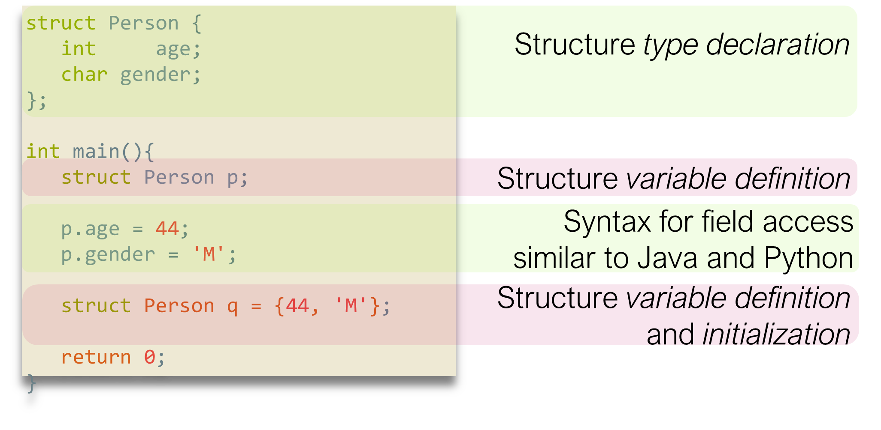
Structure Example

Slide 32
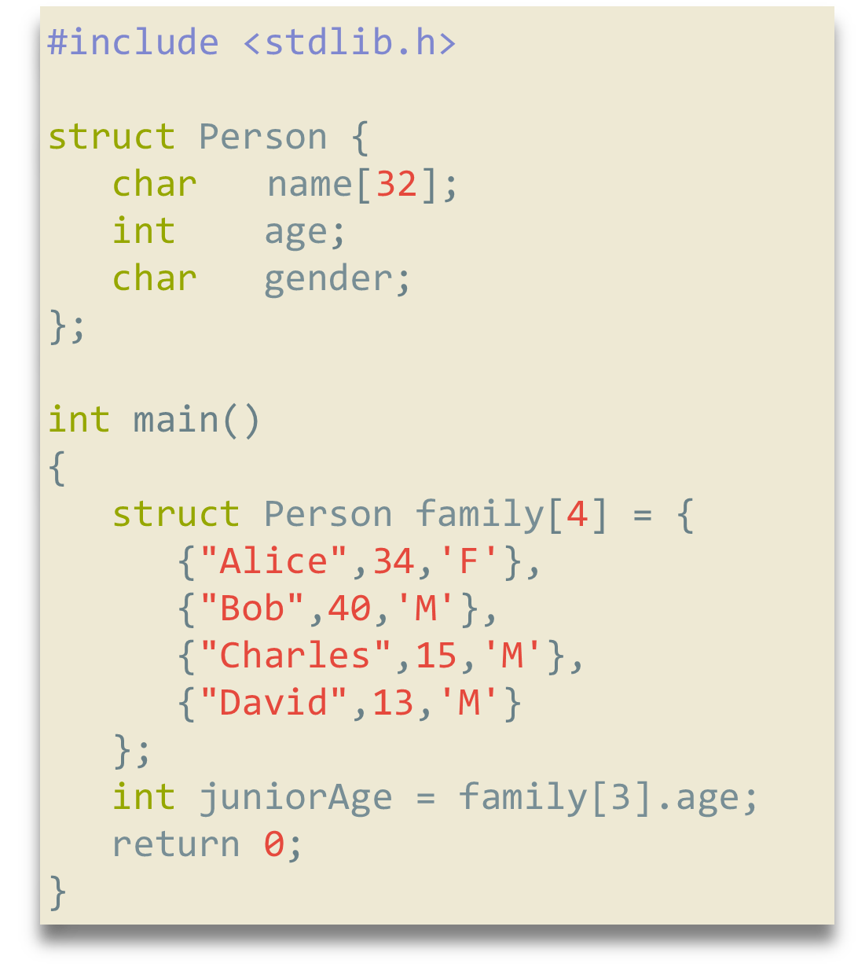
Example: Array of Structures
Member name is a char array
Caveats
  Names cannot be more than 31 characters long
  Four persons in family
    Indexed 0..3
Array of structures for the whole family
  Nested initializers

Slide 33
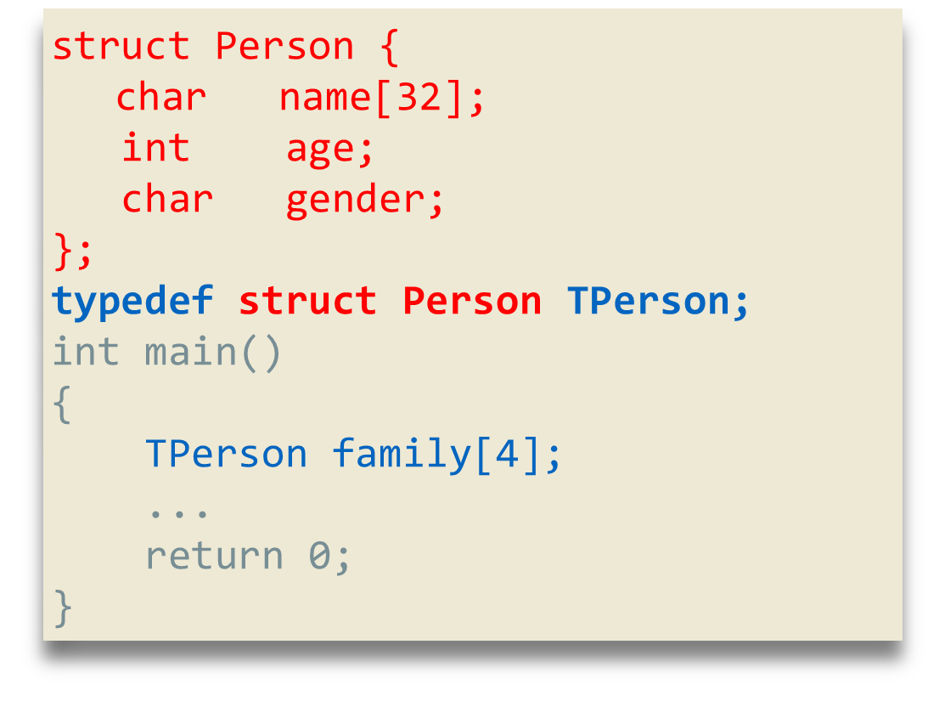
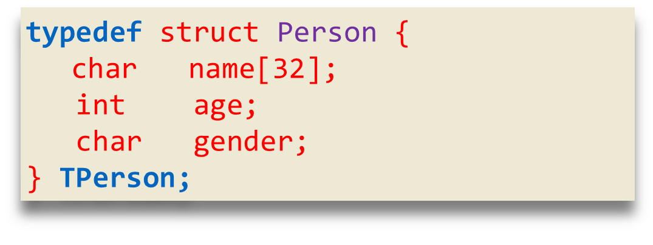
typedef
Struct names can become long
C provide the ability to define type abbreviations
  typedef declaration
    Give existing type new type name
Make code more readable
Structure and typedef declarations often combined

Slide 34
Operations on struct
Assignment
  All struct members copied
Can be passed to functions
  By value
  Even if some members are arrays!
Can be returned from a function
If pass by value, cannot change members in functions
Passing or returning large structures can be costly
Use pointers to structures!

Slide 35
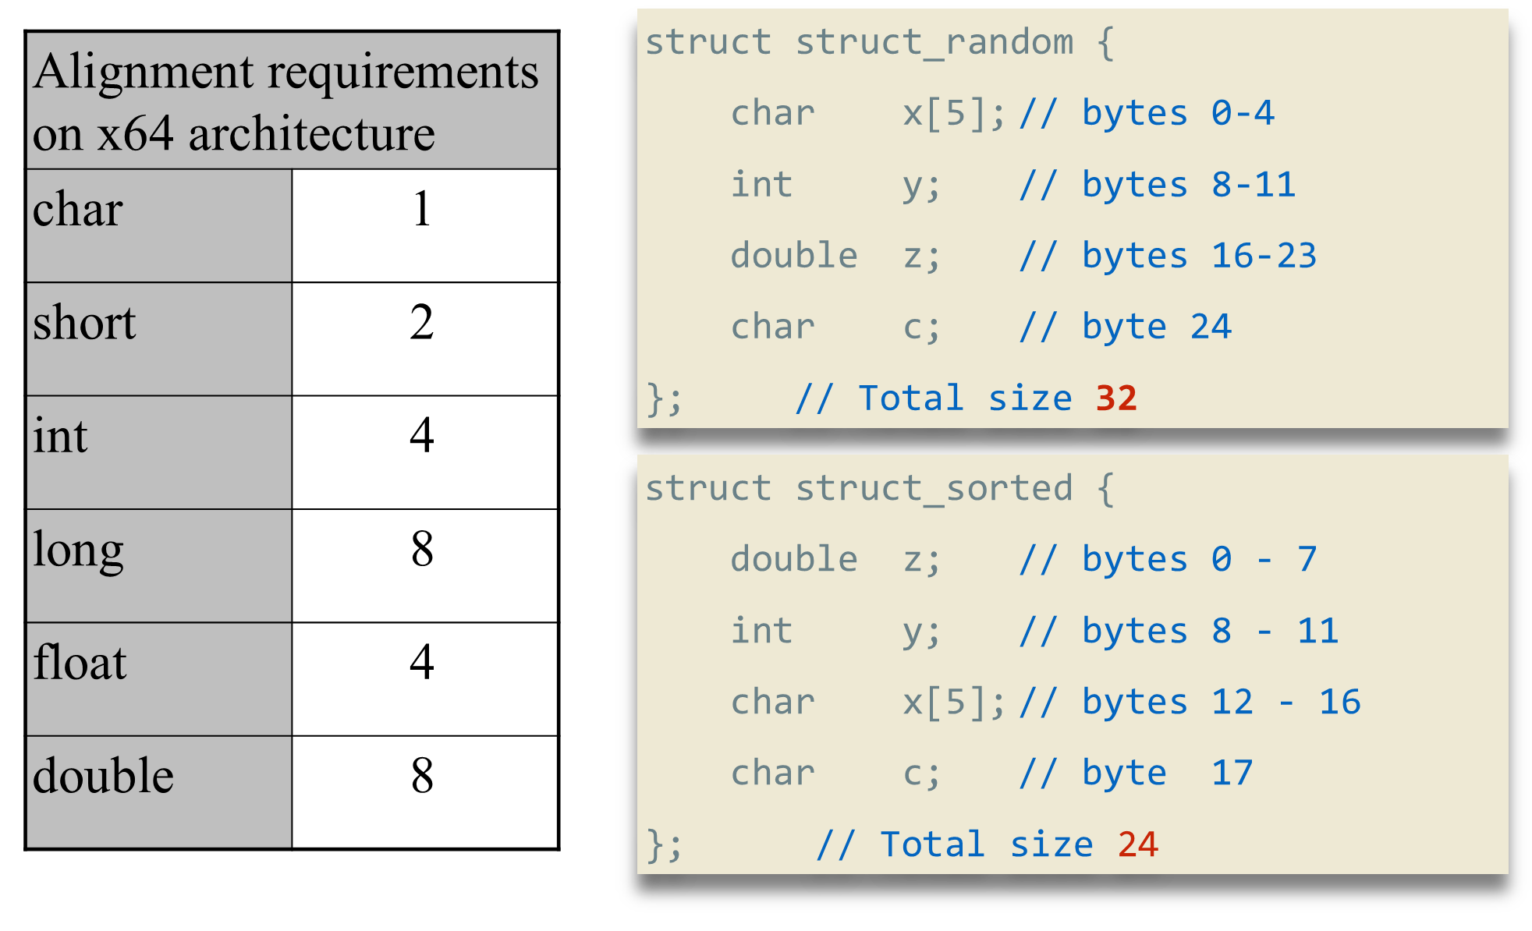
Structure Alignment
Structure members are aligned for the natural types

Slide 36


Lecture Conclusions
As a language C offers an extremely large amount of control over the code you program.
This also makes it very challenging to learn and pick up.
You DO NOT want to be like the meme shown on this slide.
You should understand how to use pointers, arrays and which variables use which memory.
Understand how to create structures in C.

Slide 37
Figure Sources
https://i.kym-cdn.com/photos/images/newsfeed/001/608/838/9f2.jpg
https://img.memegenerator.net/instances/62930796.jpg
https://i.kym-cdn.com/entries/icons/original/000/028/596/dsmGaKWMeHXe9QuJtq_ys30PNfTGnMsRuHuo_MUzGCg.jpg
https://mediaproxy.salon.com/width/1200/https://media.salon.com/2013/07/2001_monolith.jpg
https://programmerhumor.io/wp-content/uploads/2023/01/programmerhumor-io-python-memes-backend-memes-e1c8fbd8d3296f0-608x596.jpg

